Slide 1
Adversarial Search Methods for Two-Player Board Games
Halma Game
By: Nikolas Ivakko & Vasco Bartolomeu

Slide 2
Agenda
Problem Definition
What is Halma?
Adversarial Search
State Representation Halma
Minimax Algorithm
Evaluation Functions
Human Interface

Slide 3
Adversarial Search
Search algorithm used in artificial intelligence
In game theory: find best strategy in competitive games (here: two-player board game)
Maximizing/Minimizing own/opponents utility, respectively
In board games popular due to determinism and completely observable environment
Minimax Algorithm with usage of Alpha Beta cuts
Monte Carlo Tree Search
Selection of best move

Slide 4
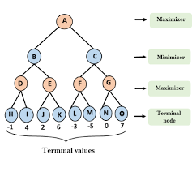
Minimax algorithm
Goal: find best move
Assumption: Opponent is optimal
Choosing best possible outcome while considering opponents positions
Depth first tree building until given maximum depth
Score assignment through evaluation function to terminal states
Recursive state-tree exploration (backpropagation to root node)
Alternating min/max consideration

Slide 5

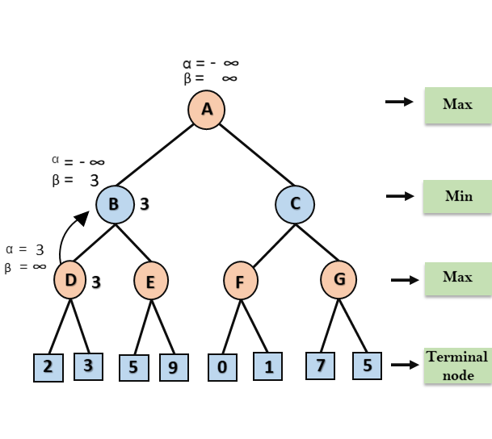
Alpha-beta cuts
Enhancement through alpha-beta pruning
Reduction of branches to explore
Exploiting the fact that node in a branch is worse than previous evaluations
Cutting of branches in sub-tree
Cutted branches won’t be explored
Memory usage improved, especially when large branching factors

Slide 6
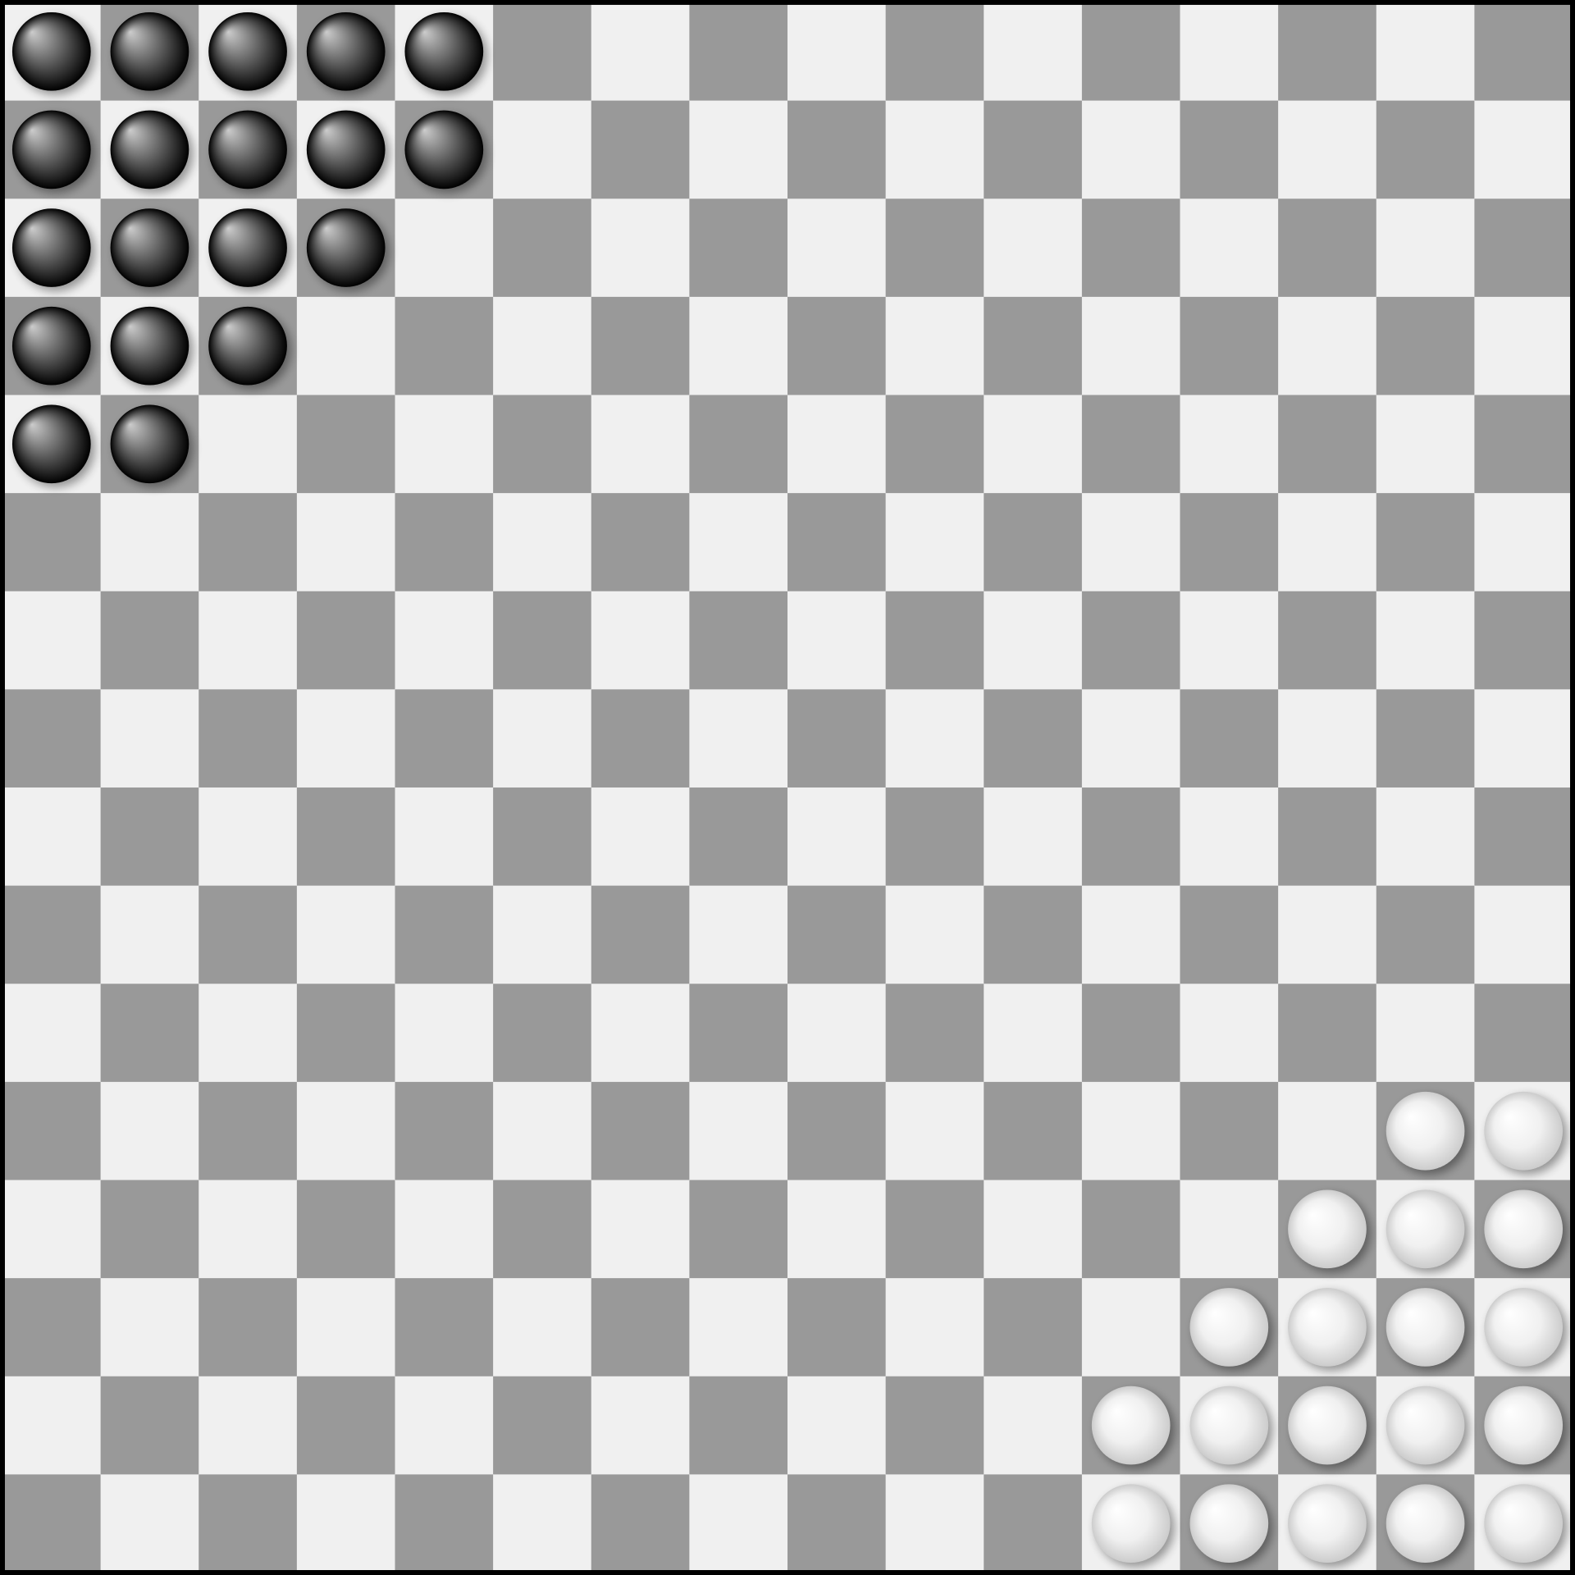
Halma game
Two or four player strategy board game
16x16 Chekerboard
Two player: 19 pieces
Four player: 13 pieces
Goal: move all own pieces into “homebase” – opposite corner
No captures

Slide 7
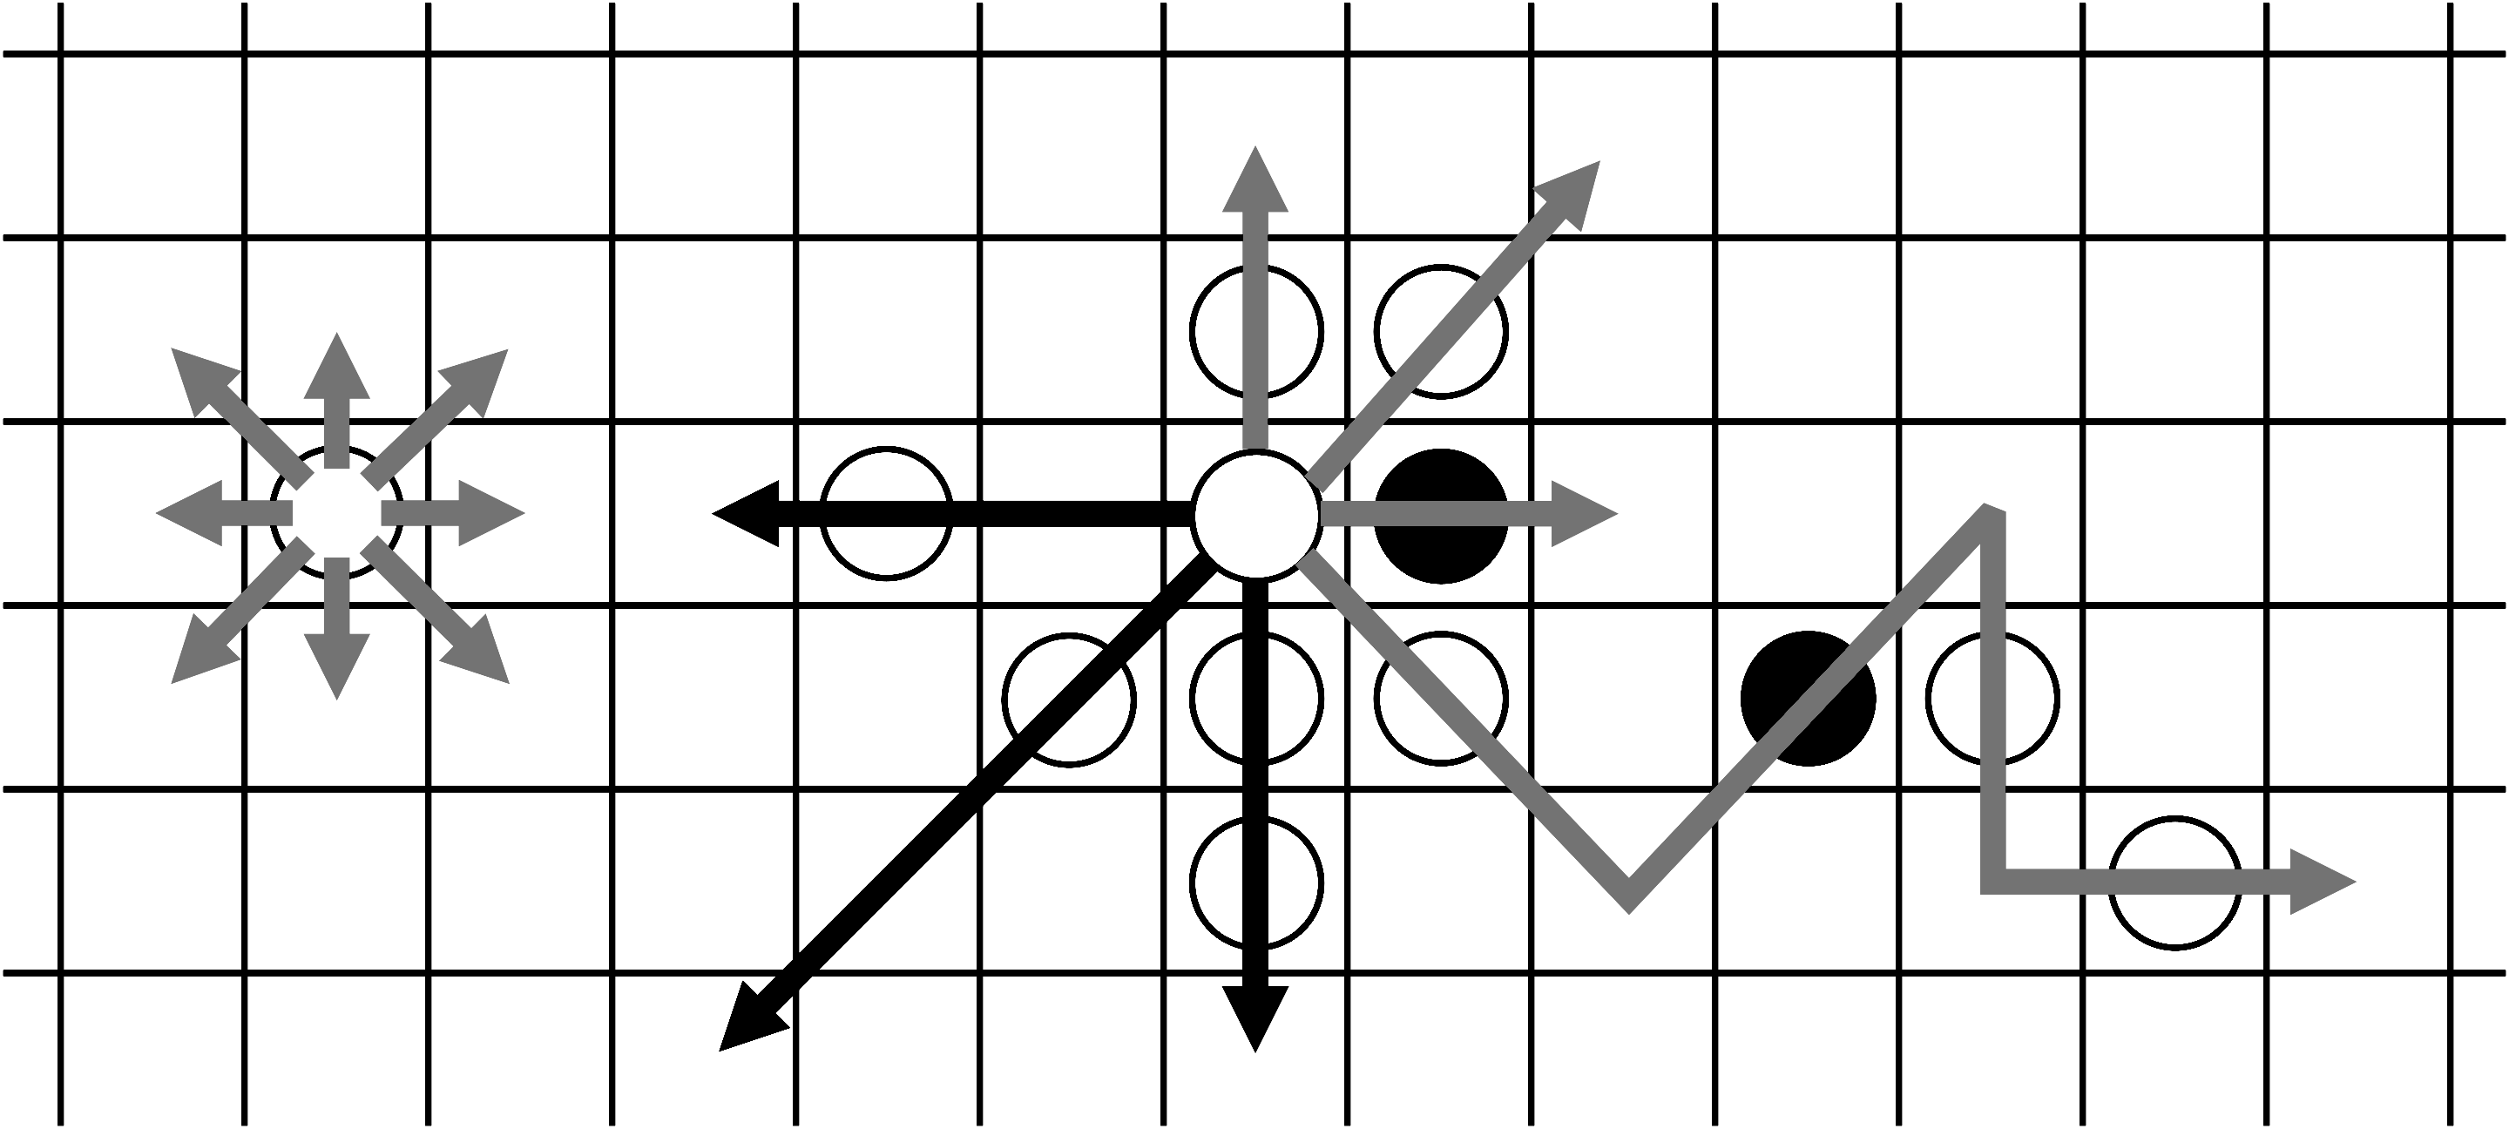
Rulebook
Moves:
Move to adjacent free square – turn terminates
Jump over own or opponents piece
Consecutive jumps allowed
Once a piece inside homebase it can not leave but move inside
In AI: building of search trees without cycling
Large search space
Approx. 10^50 possible positions

Slide 8
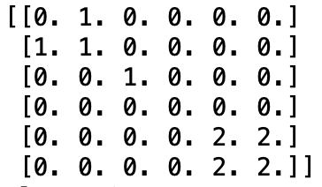
State representation
Two approaches:
Full board state representation (Rows, Columns..)
token index representation

Slide 9
Operators
Single Move to adjacent square
Precondition: adjacent square is free, Not moving outside of homebase
Cost: Moves towards goal will be rewarded in evaluation function
Jumps and jump-sequences
Precondition: adjacent square is occupied, square on opposite side is free
Cost: Moves towards goal will be rewarded in evaluation function

Slide 10
Evaluation functions
Two main approaches :
Eucldian distance measure for each token towards closest, not self-occupied Square in Homebase. Sum Of distances subtracted by oppponents equivalent Then Player will minimize overall distance, opponent assumed to maximize
Following same structure as in 1, only evaluation of own benefit (no subtration)
- Further ideas: Board center control, minimum moves towards homebase

Slide 11
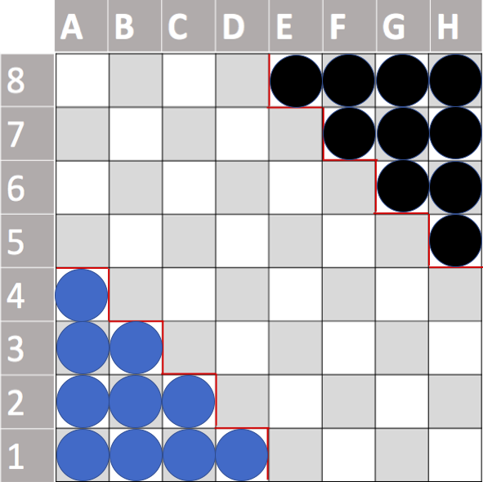
Evaluation function description

Slide 12
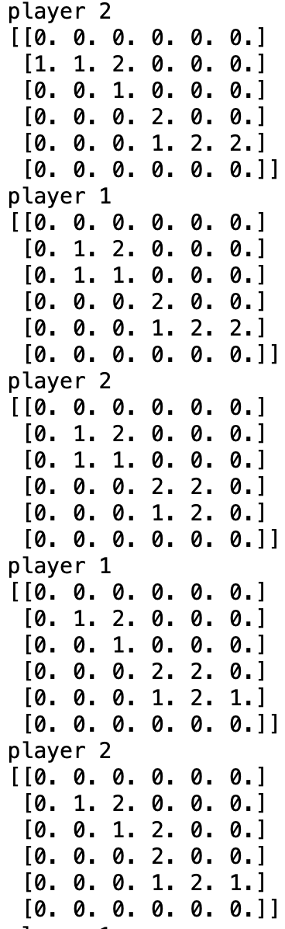
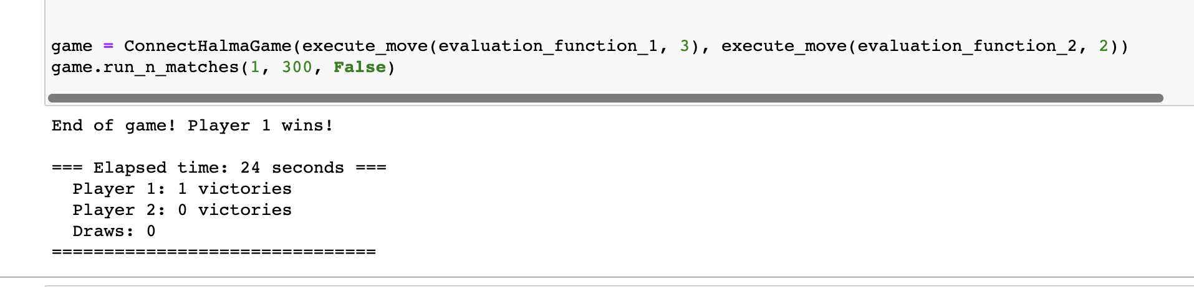
Game Implementation
Two-player game defintion
Agent:
Specification of evaluation function used by each „Agent“
Tree Search depth
Human/ Random:
Choose Move to execute
Overall Score representation and Duration
Game Process visualization possible

Slide 13
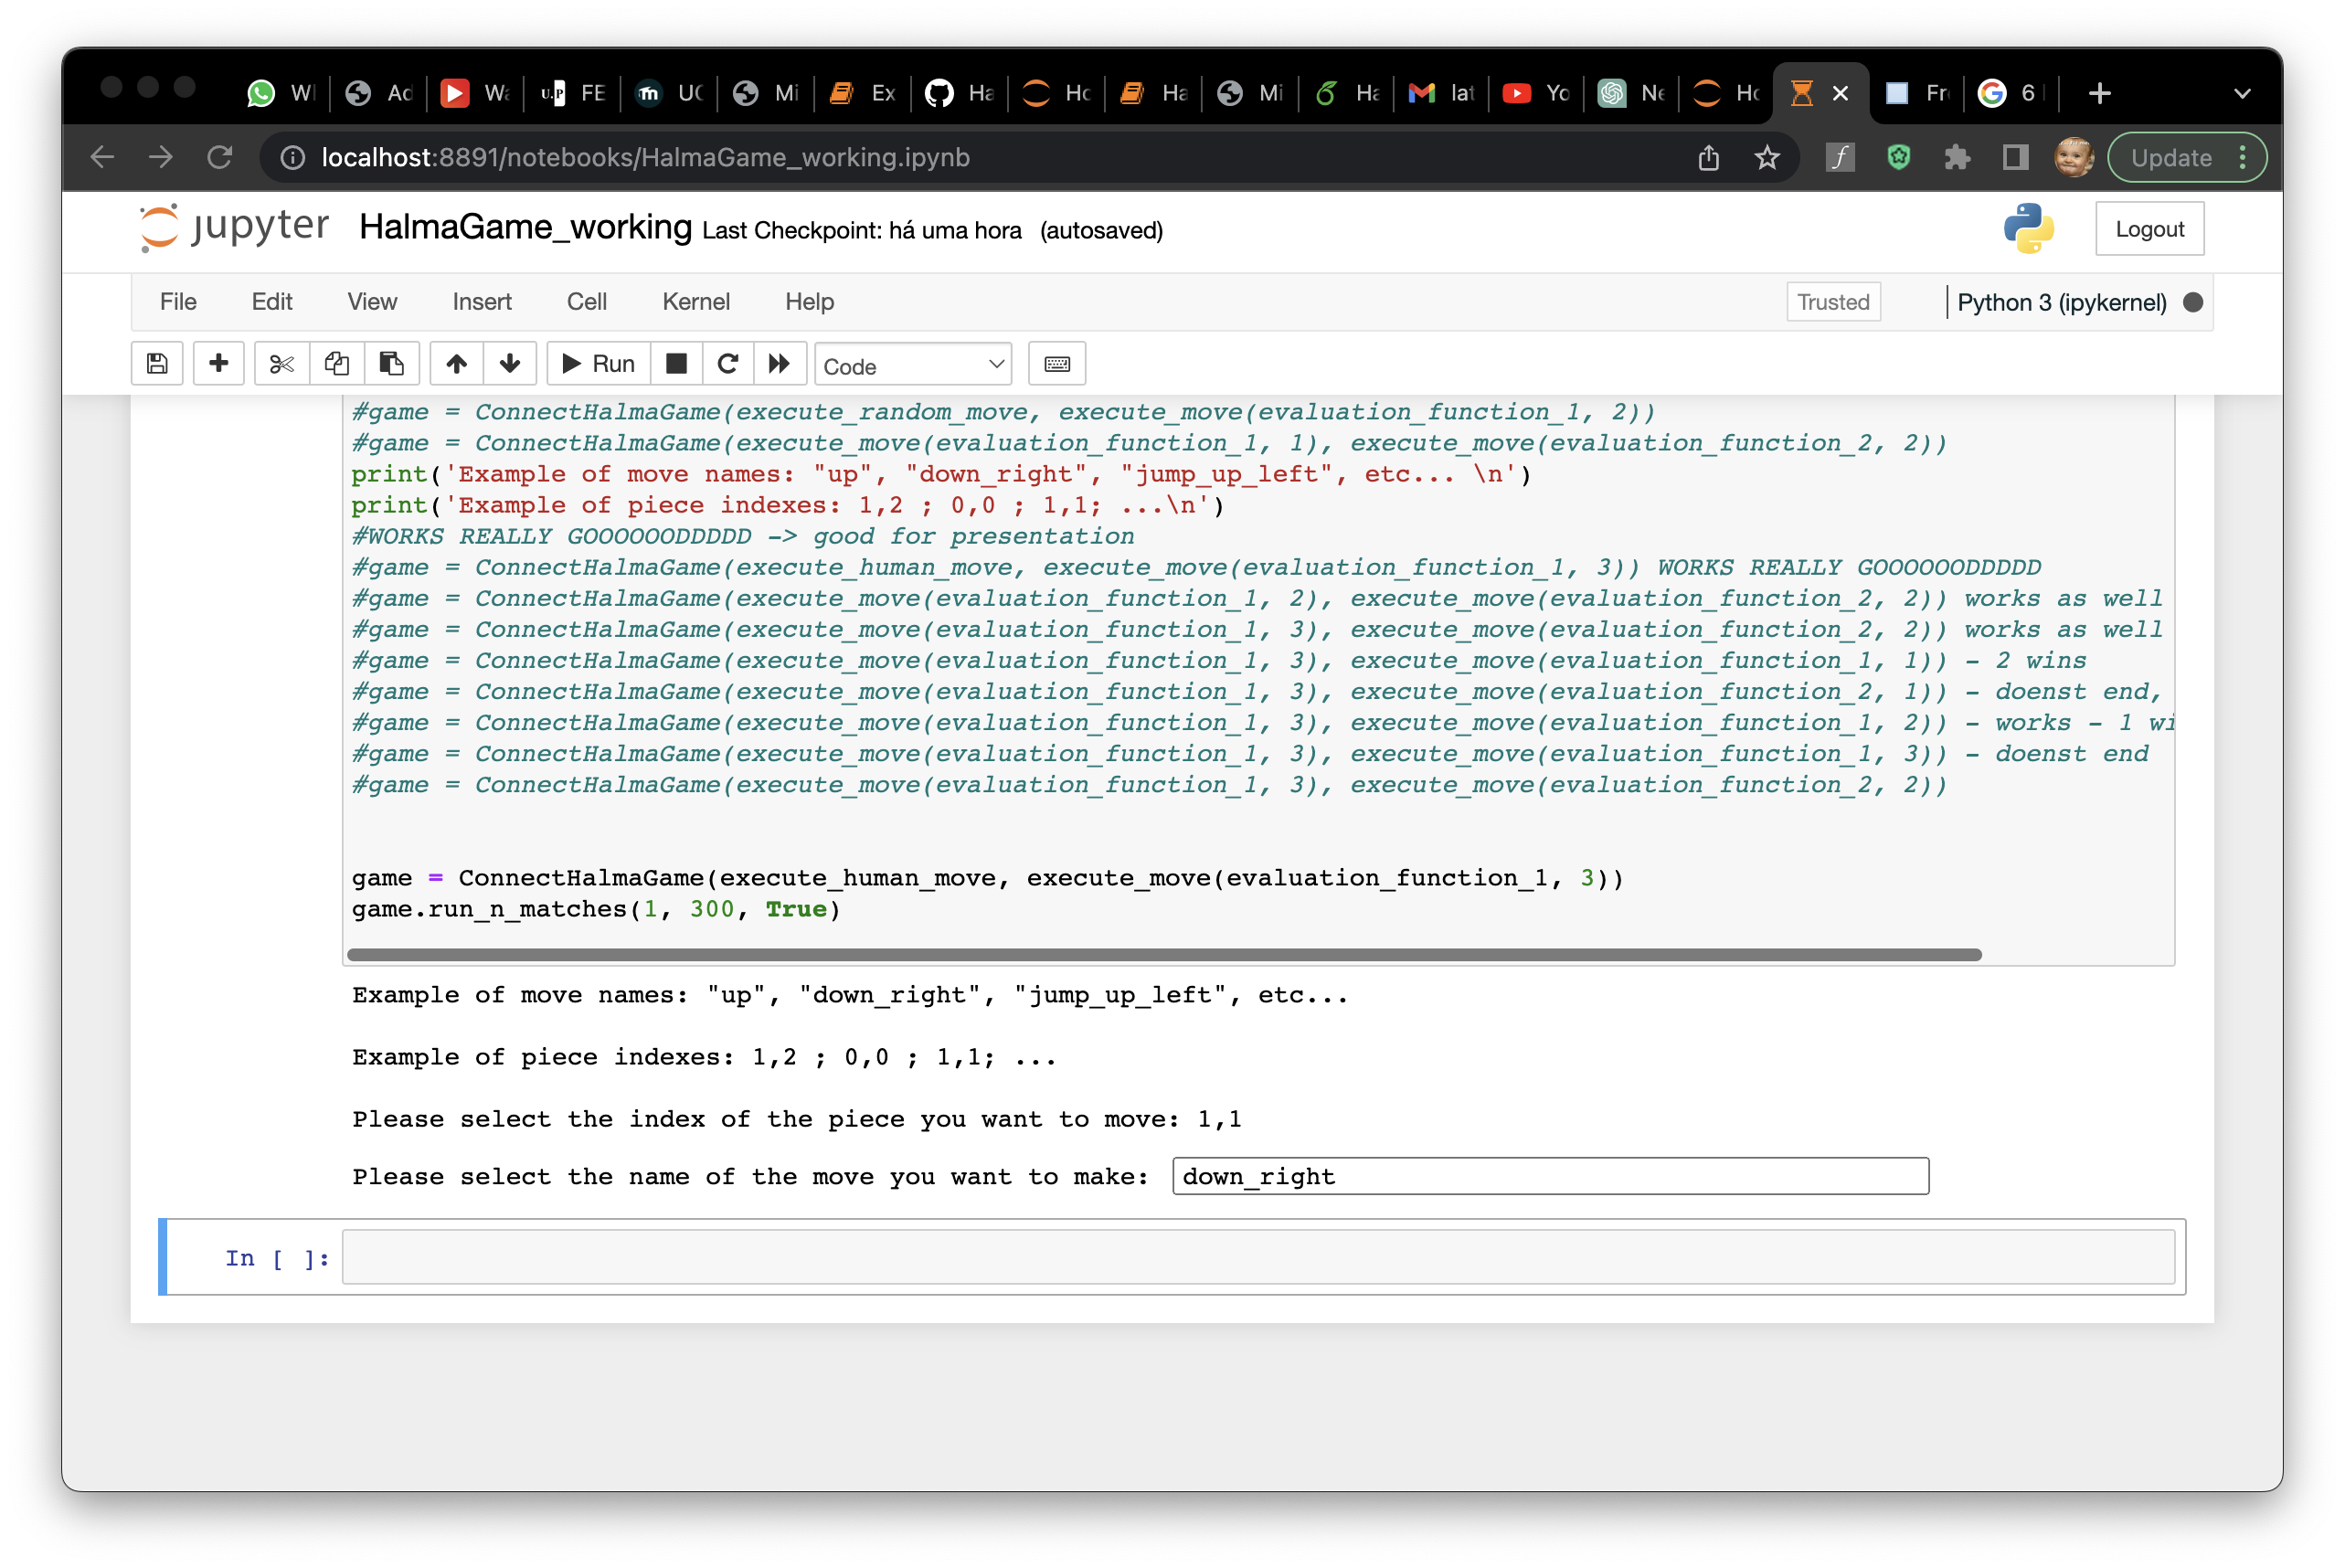
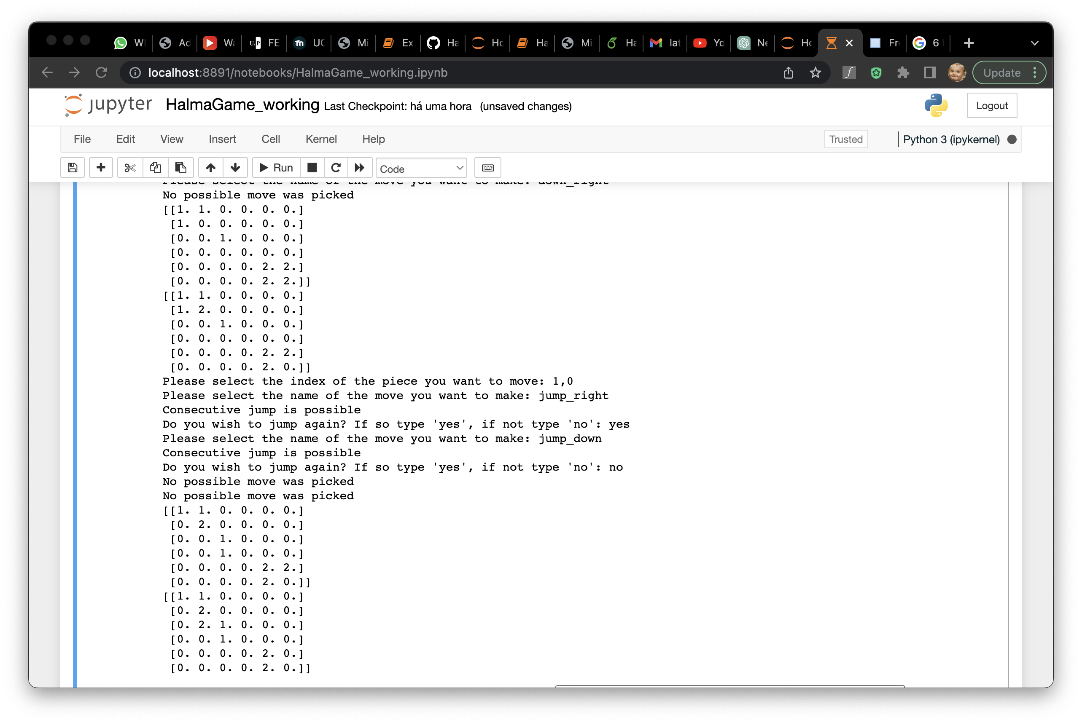
Human interface instructions
interact with the game for each turn :
Index of piece to be moved
Move to execute
In case there of multiple jumps possible:
Option to terminate turn
Execute new jump

Slide 14
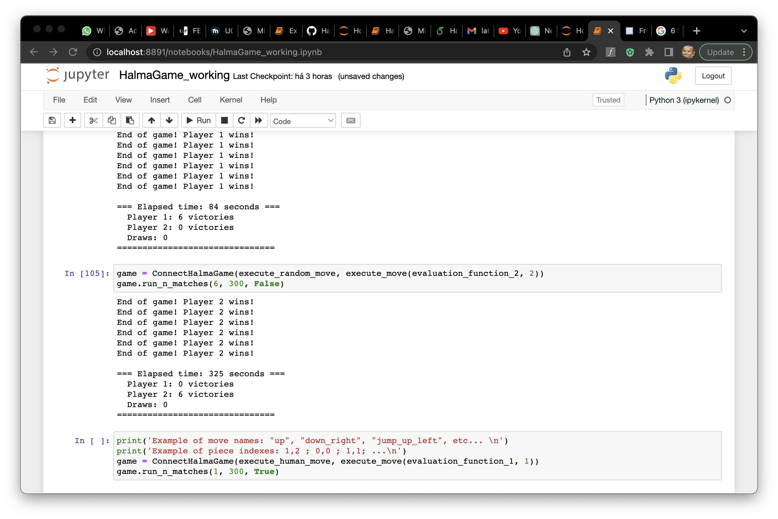
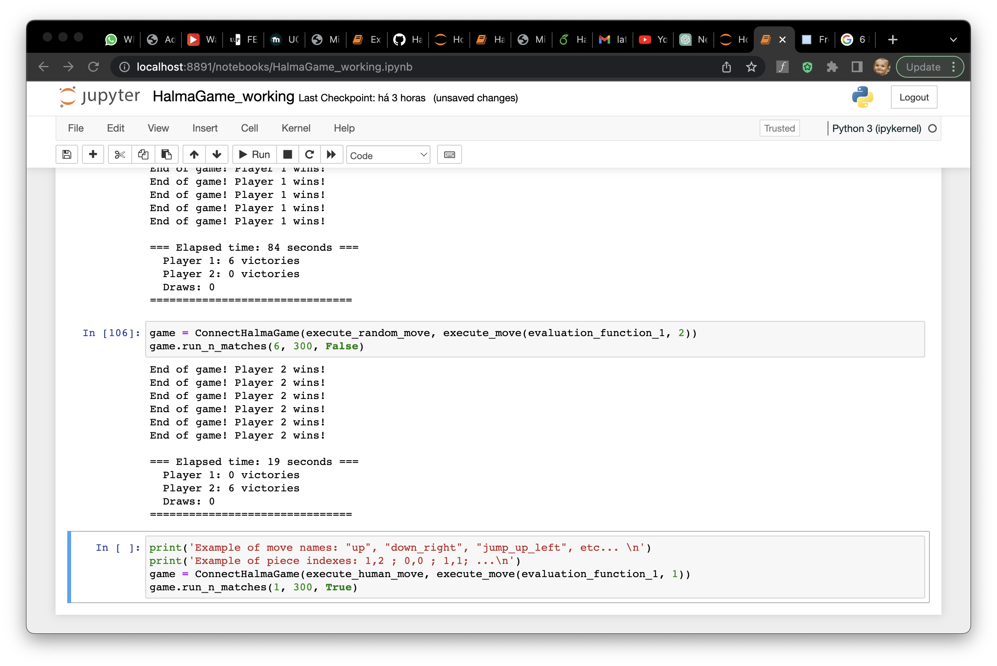
Result analysis
Agent 1 ( Random )
AGENT 2 (EVAL_2, DEPTH = 1)
Agent 1 ( Random )
AGENT 2 (EVAL_1, DEPTH = 1)

Slide 15
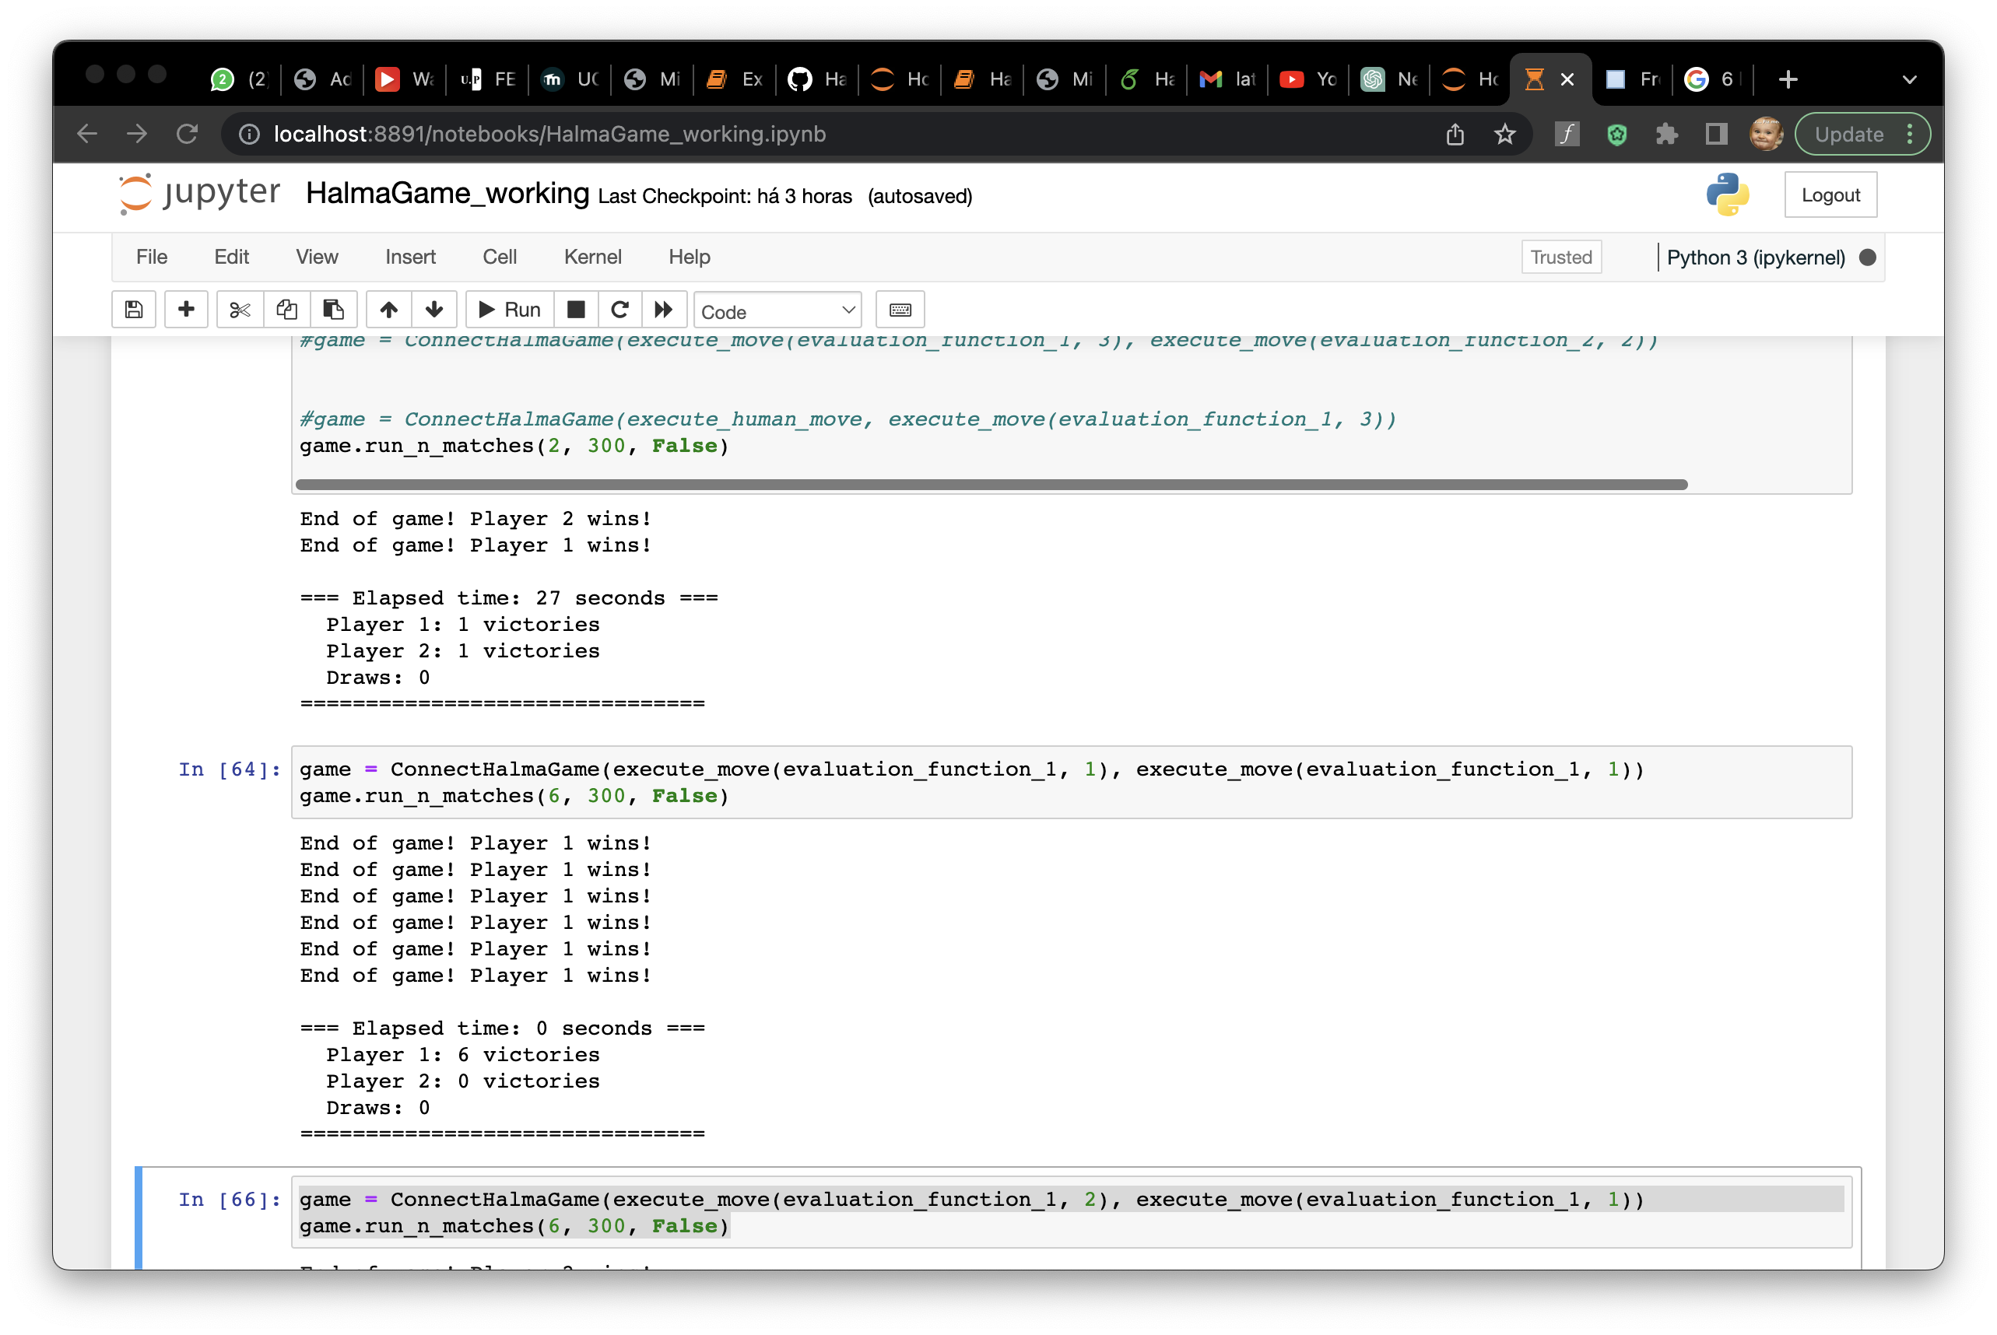
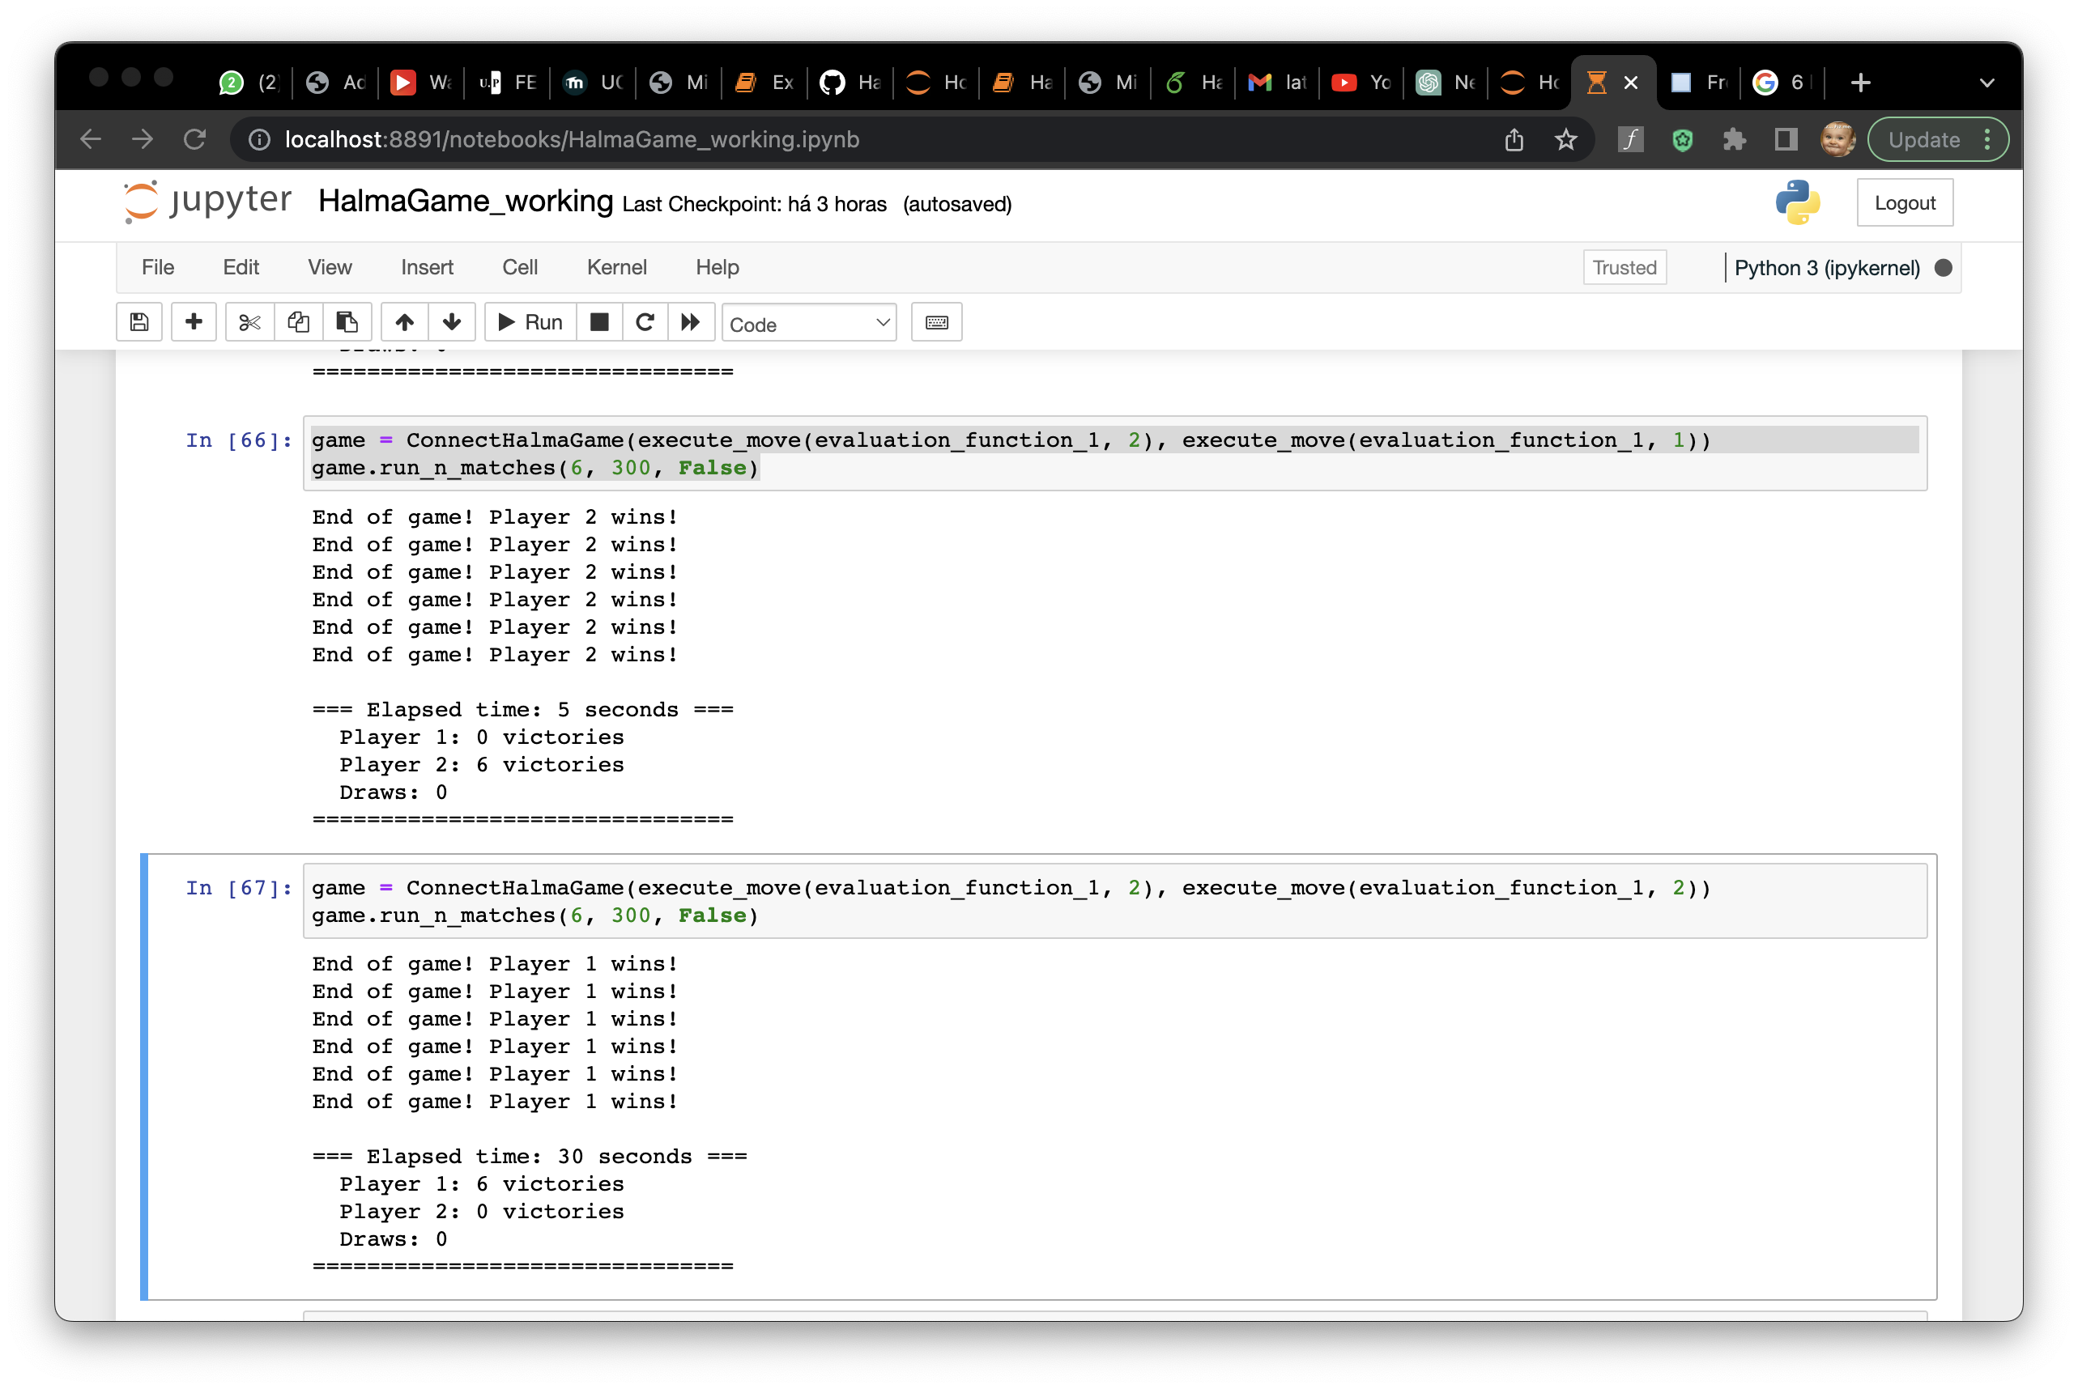
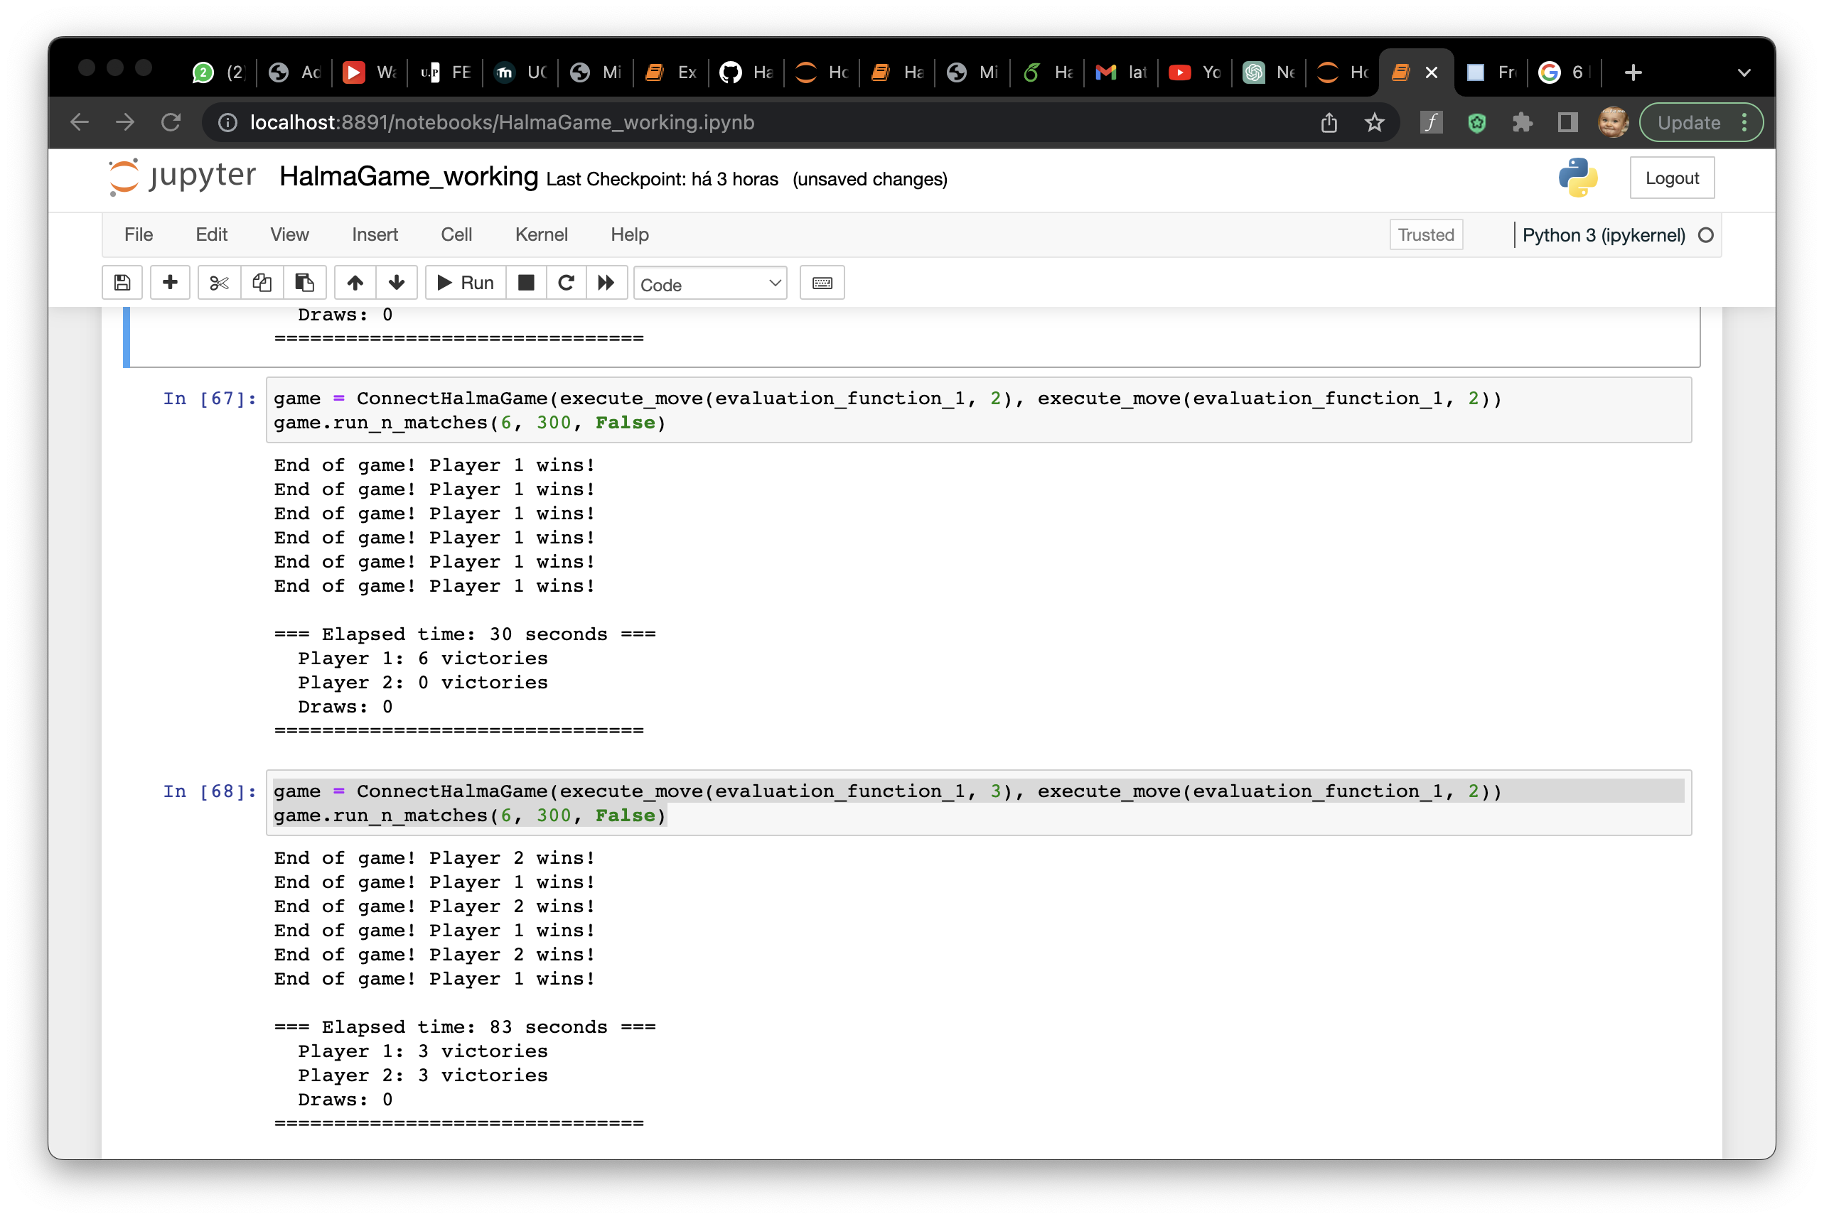
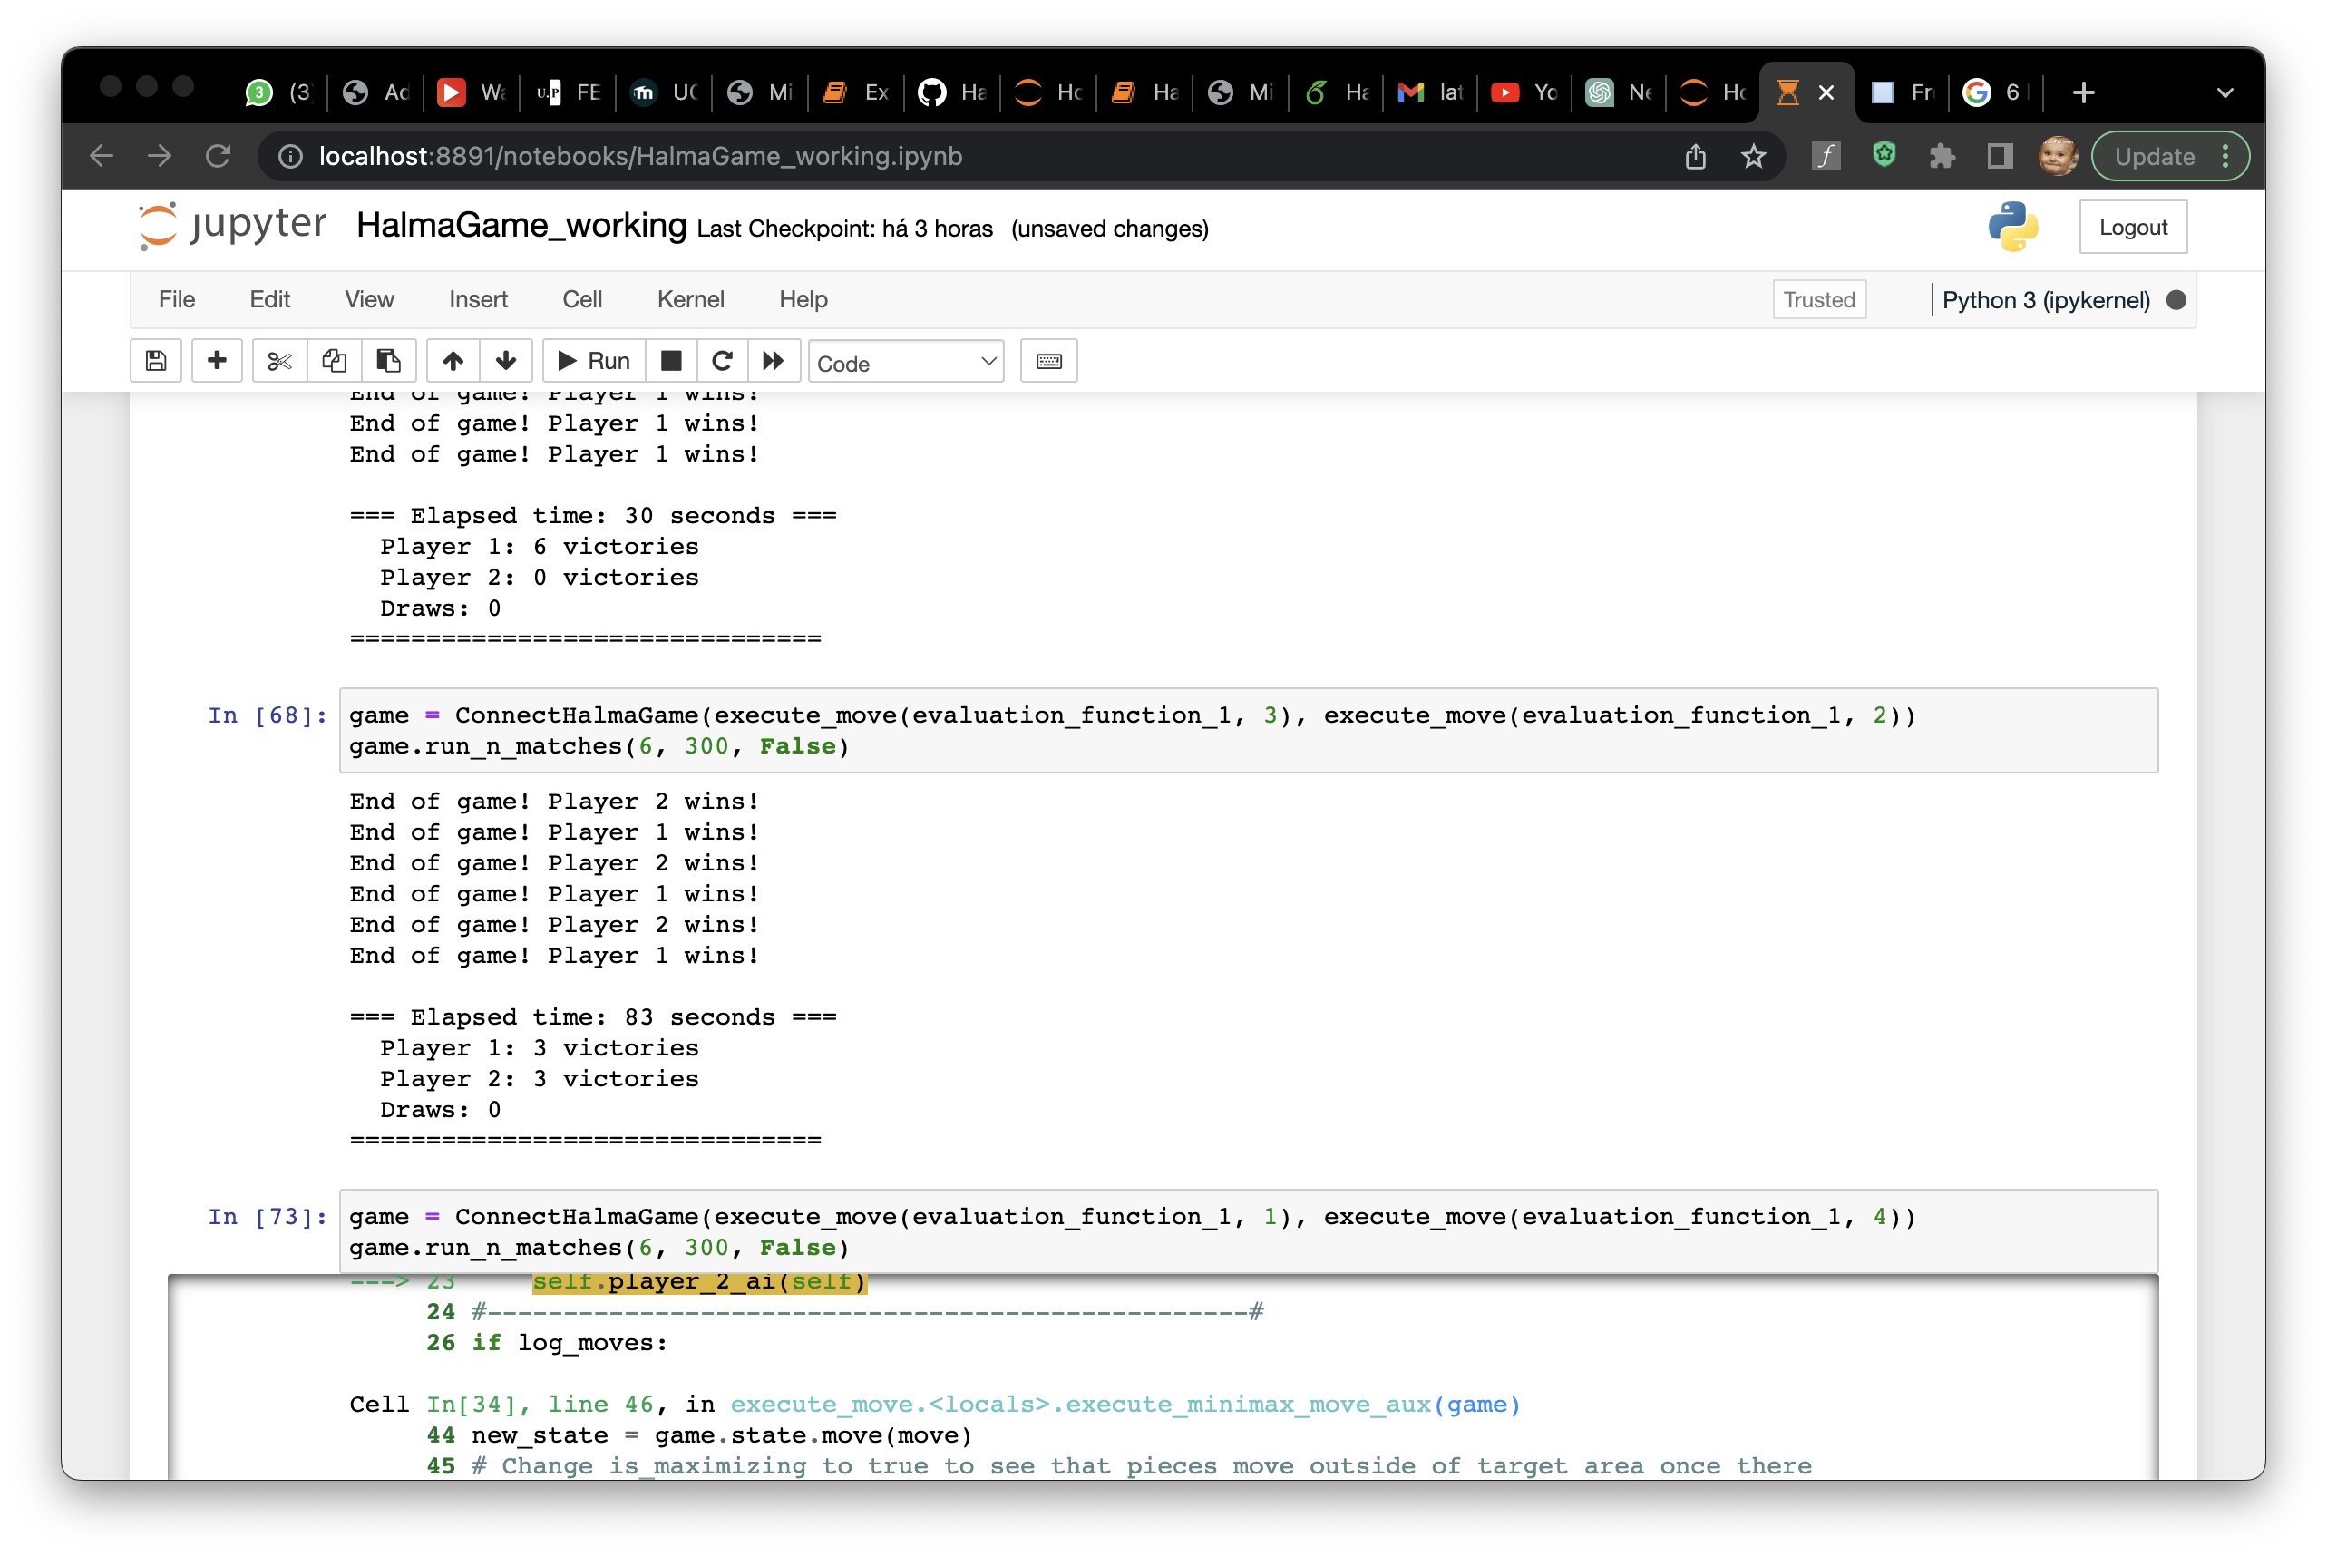
Result analysis
Agent 1 ( EVAL_1, DEPTH =1)
AGENT 2 (EVAL_1, DEPTH = 1)
Agent 1 ( EVAL_1, DEPTH = 2)
AGENT 2 (EVAL_1, DEPTH = 1)
Agent 1 ( EVAL_1, DEPTH = 2)
AGENT 2 (EVAL_2, DEPTH = 2)
Agent 1 ( EVAL_1, DEPTH = 3)
AGENT 2 (EVAL_2, DEPTH = 2)

Slide 16
Conclusion and future work
To finalize this presentation we would like to point out a few aspects of the algorithm implemented:
Algorithm can‘t figure out last move
Human Interface can crash if infeasible move is executed
….

